Slide 1


Hardware and Network Optimizations for CET Designer
(stuff only geeks care about)
Jason is so DREAMY!!!
Jason Lund
Director of IT
Target Commercial Interiors
Minneapolis, MN

Slide 2
Topics
About us (isn’t it always?)
User Hardware Update
Network speed & CET
CET Designer 3.0
Payback – our ROI from CET
What’s next for TCI + CET-D?

Slide 3
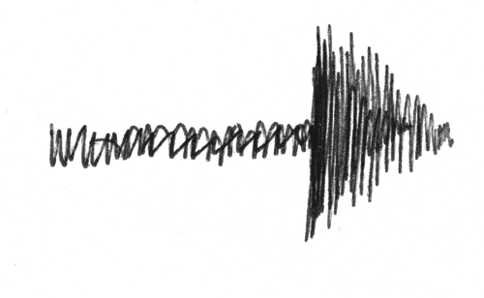
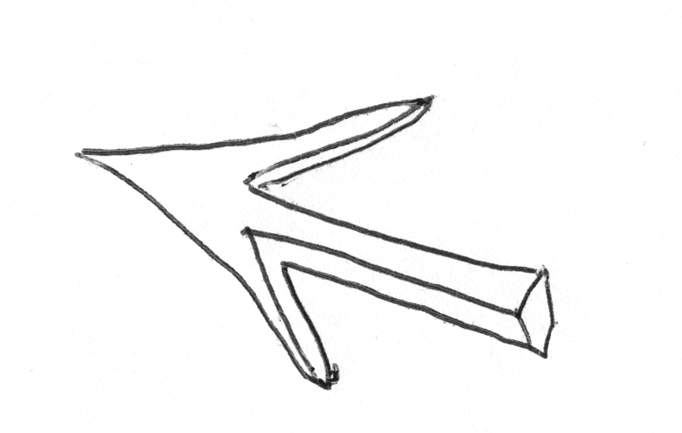
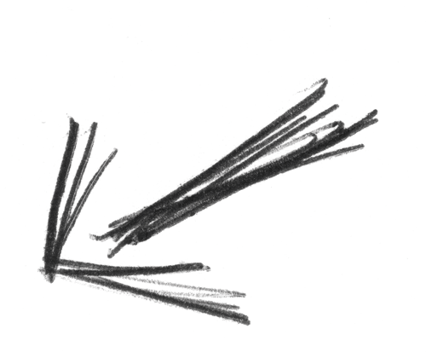
The Business:
Steelcase Platinum Partner (2012)
Based on Minneapolis, MN
9 locations in 4 states (MN, AZ, WI, IL) + India
$130-140 million in sales projected for 2012
160 team members & contractors
30 design geeks + 5 marketing nerds
The Technology:
IT infrastructure is “hub and spoke” – remote data center
VMware server & desktop virtualization (private cloud)
Annual “all-in” IT expense budget has 2 commas…
Team of 3 techs, outsourced helpdesk (for now…)

Slide 4
No, I will not turn my head to the side and cough....
.. because hardware is no longer a pain in the ass!

Slide 5
Sager NP9130 Gaming Notebook
.. It just works for TCI and other dealerships.
Faster CPU = better
16 gigs of RAM minimum, 24-32 is great
240 gig SSD, only $60 more than a 180
Second HDD and external optical drive?
Video production considerations.
Warranty?
Nvidia drivers & dual displays – the ongoing saga (not a Sager problem).

Slide 6
The Network
Holland > Sweden
Riverbed helps, not perfect.
Windows Server 2012 BranchCache
Local server storage & folder replication (DFS)?

Slide 7
Payback – our ROI from CET Designer
Things that didn’t happen:
Big savings from CAP licenses...
More money for hardware
Deploy the tool to sales or marketing.

Slide 8
Payback – our ROI from CET Designer
Things that DID happen:
A higher sales win rate on bids that include CET Designer renderings.
Managed a $50 million increase in sales volume without adding designers.
Slowly decreasing legacy CAP projects and converting or replacing with CET Designer files.

Slide 9
CET Designer 3.0
Note: If you show up to the user conference and harass the developers 3 years in a row about the same thing they will change their license model!
Reduced IT time supporting CET Designer
No more “WTF do I buy” hardware issue
Managing user licenses
Making hardware swaps
Deploying new or upgraded laptops
Easier to limit elevated laptop security privileges*
* no thanks to Project Matrix…

Slide 10
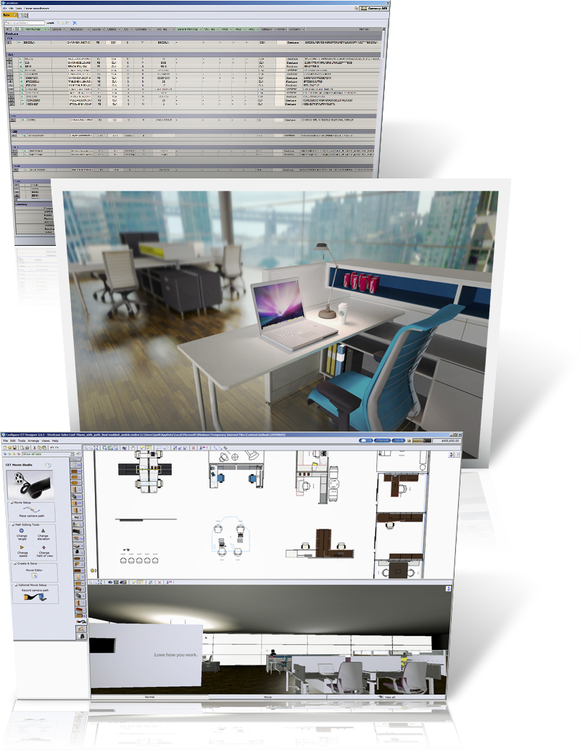
What’s next for TCI & CET Designer?
Expandes sales video library & bid packages
Virtual showrooming
Smaller/lighter laptops?
Centralized photo/movie rendering.

Slide 11
Questions?
Jason.Lund@targetinteriors.com
Thank you!

